Slide 1
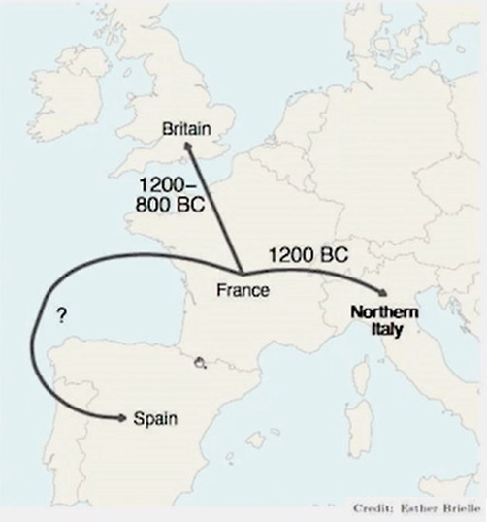
Prof. David Stifter
Maynooth University
The Celticisation
of the Western Archipelago
An exercise in model-building
Arbeitstagung der Indogermanischen Gesellschaft
‘The Secondary Homelands of the Indo-European Languages’
Universiteit Leiden
5th–7th September 2022

Slide 2
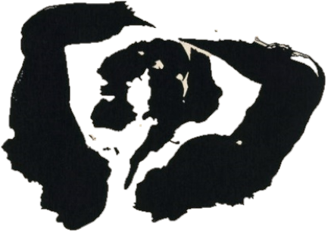
Models of language spread
Linguistics
Archaeology
Uneasy bedfellows
The Táin. Pillow talk, Louis le Brocquy (1969)

Slide 3
Models of language spread
Linguistics
Archaeology
Genetics
Genetic data:
better proxy for language spread
aDNA anchors populations in time and space
Any theory about prehistoric language distribution is speculation.

Slide 4
Outline
Focus:
Early Bronze Age, Britain and Ireland (c. 2450–2000 b.c.)
Late Bronze Age, Britain and Ireland (c. 1200–800 b.c.)
Iron Age, Ireland (first half 1st millennium a.d.)

Slide 5
I. The Early Bronze Age
Britain and Ireland 2450-2000 b.c.

Slide 6
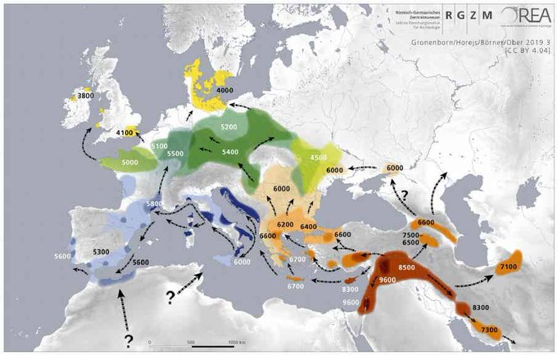
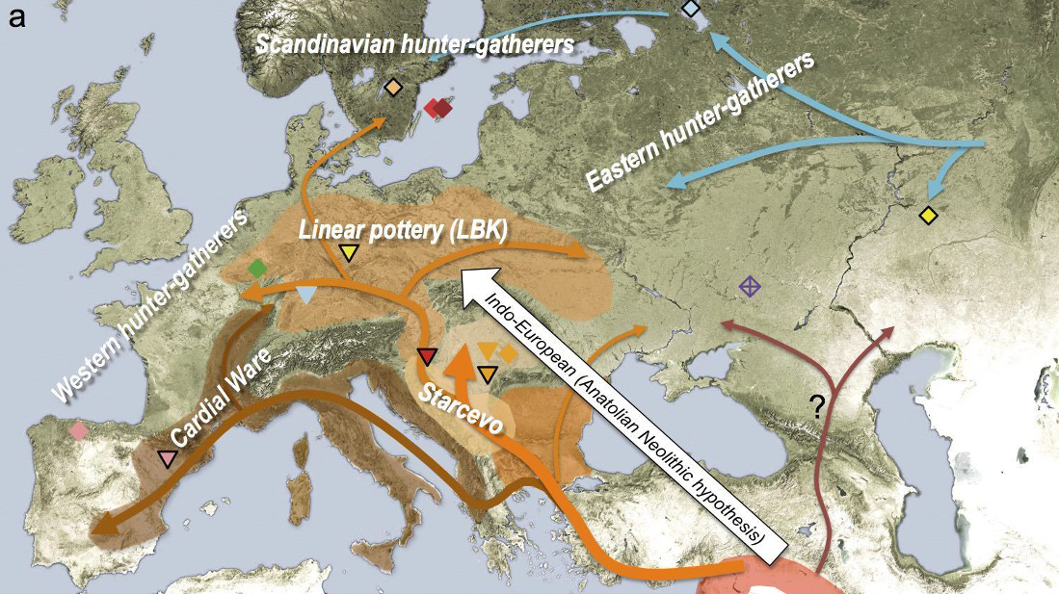
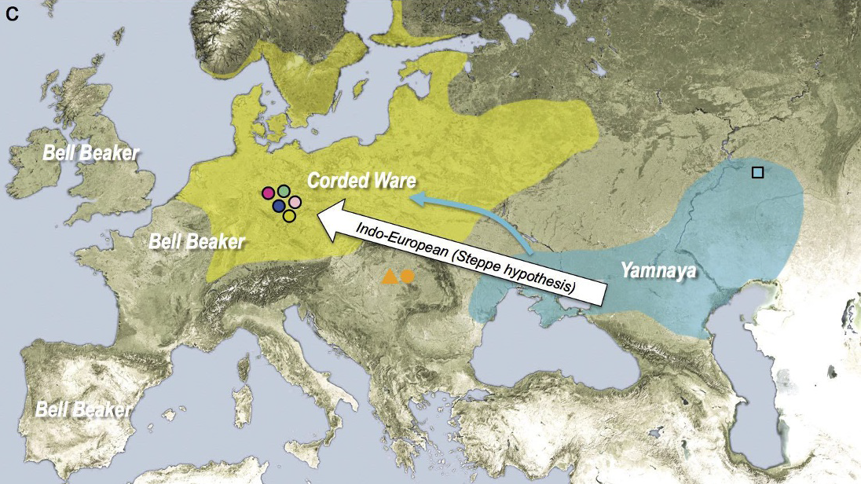
I. Early Bronze Age: Genetics
Illustration: RGZM 2019
Illustrations: Haak et al. 2015: 217

Slide 7
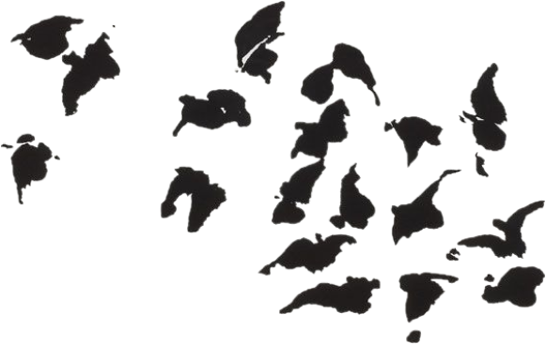
I. Early Bronze Age: Neolithic Early European Farmers
The language of the Early European Farmers:
numerous loans into European languages
Schrijver 1997: formal criteria for identifying loans
bird names, agricultural products
a-prefix with ablaut-like behaviour
Schrijver: ‘language of the bird names’
‘a-prefix language’
Stifter 2010: ‘Avidic’
Schrijver 2018: related with Hattic, Minoan and Sumerian?
Birds
The Táin. A flock of birds, Louis le Brocquy (1969)

Slide 8
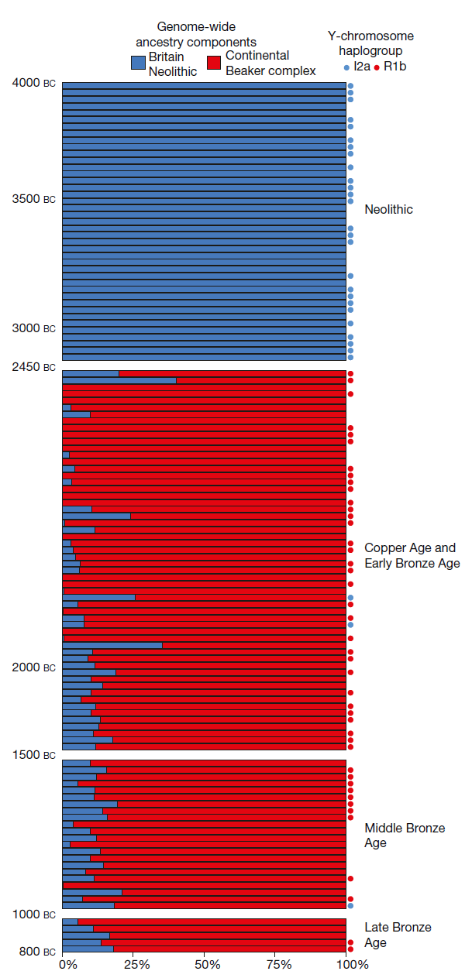
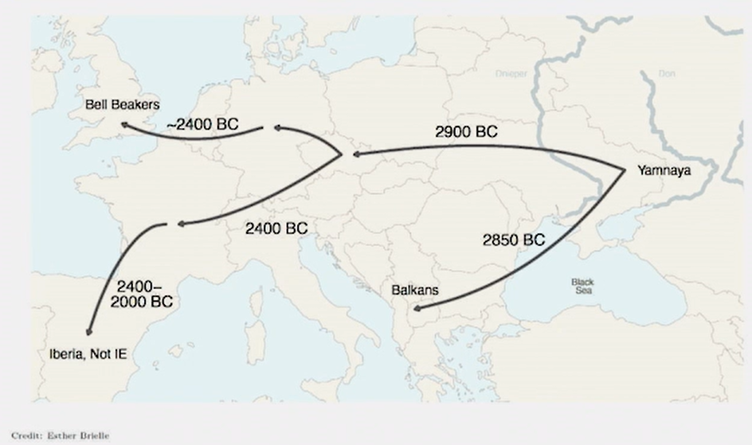
I. Early Bronze Age: Britain & Ireland
Illustration: N. Patterson 2022
Illustration: Olalde et al. 2018: 193

Slide 9
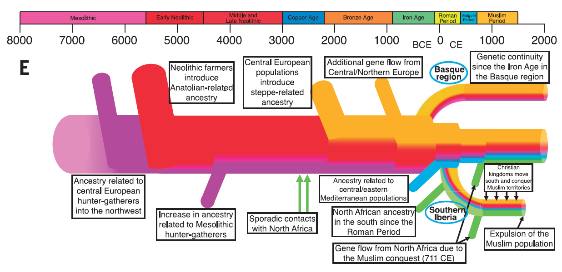
I. Early Bronze Age: Genetic fallout 1
Hamito-Semtic a.k.a. Afro-Asiatic Substratum Hypothesis:
syntactic peculiarities of Insular Celtic is due to substratum effect of Hamito-Semitic-type predecessor language, e.g.
J. Pokorny
H. Wagner 1959
O. Gensler 1993
G. Broderick 2013
methodological critique, e.g.
St. Hewitt 2007
G. Isaac 2007
no specific genetic link with Western Archipelago
Moorjani et al. 2011
Cerezo et al. 2012
Botigué et al. 2013
A geinéolchu,
nom·aithbéoaigid!
Illustration: Olalde et al. 2019: 1232

Slide 10
I. Early Bronze Age: Genetic fallout 2
‘Celtic from the West’ Hypothesis:
IE reached Atlantic zone c. 5000 b.c. with Neolithic revolu-tion, Celtic arose c. 3000 b.c. as lingua franca along Atlantic seaboard, then spread eastward
J.T. Koch & B. Cunliffe 2010, 2013, 2016, 2019...
methodological critique, e.g.
G. Isaac 2004
J. Eska 2013, 2014
P. Sims-Williams 2020...
genetic links along Atlantic littoral?

Slide 11
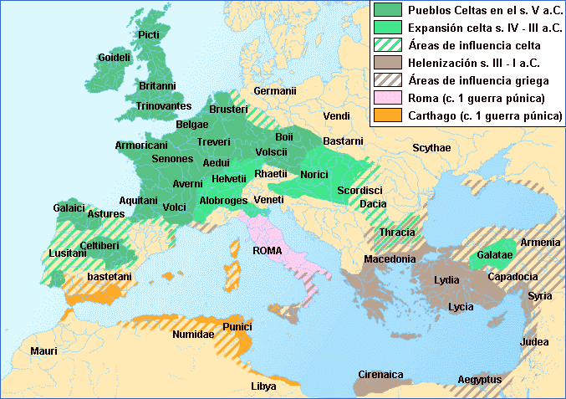
I. Early Bronze Age: And then?
EBA Britain & Ireland:
Cassidy et al. 2016: 371:: “…some level of local continuity at the edge of Europe persisting over 4,000 y.”
Cassidy et al. 2016: 368: “This turnover invites the possibility of accompanying introduction of Indo-European, perhaps early Celtic, language.”
?
Illustration: Instituto Geográfico Nacional

Slide 12
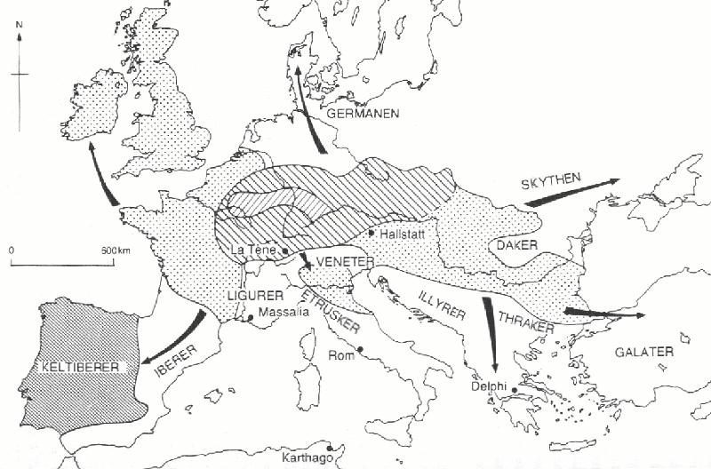
I. Early Bronze Age: Early Bronze Age Celts?
EBA Celts in Britain & Ireland?
pro:
EBA/Bell-Beaker influx last big immigration genetically and archaeologically
contra:
similarity of Iron Age Celtic languages (e.g. Mallory 2013a: 261-262; 2013b: 28-30)
shallow time-depth of Proto-Celtic (late 2nd mill. b.c.)
loan relations with Proto-Germanic (Van Sluis, Jørgensen, Kroonen forthc.)
connection with Italic (Sims-Williams 2020)
landlocked speech community (Stifter forthc.)
?
EBA language = a lost IE branch? Indogermania Submersa?
‘Bell-Beakerish’

Slide 13
I. Early Bronze Age: ABC-Hypothesis
Summary for Western Archipelago:
4th-3rd mill. b.c.: Avidic-speaking Neolithic farmers
2450-2000 b.c.: IE Bell-Beakers with steppe an­cestry
 large-scale genetic displacement + linguistic replace- ment of Avidic by Bell-Beakerish
when oh when?: Celtic languages
 linguistic replacement of Bell-Beakerish by Celtic
Avidic  Bell-Beakerish  Celtic = ‘ABC-hypothesis’
The coming of the Celts
The Táin. Chariots, Louis le Brocquy (1969)
Corollaries:
IE etymologies for pre-Celtic substratal loans in Insular Celtic?
amount of difference between Bell-Beakerish and Celtic?

Slide 14
II. The Late Bronze Age
Britain 1200-800 b.c.

Slide 15
Neolithic Early European Farmers
An LBA vector for Celtic?
Patterson et al. 2022: influx of genes from France into South Britain 1200-800 b.c.
And Ireland…?
not much data… yet
but rise of hillforts in LBA (cf. J. Mallory & W. O’Brien, Celtic from West 3)
population decline after 800 b.c.
France:
a hot-spot for the emergence of Proto-Celtic, after shift from local non-IE language?
Way forward:
more Irish aDNA data
more French/Western European aDNA data
Illustration: N. Patterson 2022

Slide 16
III. The Late Iron Age
Ireland 1st millennium a.d.

Slide 17
III. Late Iron Age: Why is Old Irish so uniform?
The homogeneity of Old Irish
extant OIr. sources (8th-9th c.) seem to reflect a uniform language without dialectal variation
Explanatory strategies:
one variety from a spectrum elevated to learned standard
the language actually lacks diatopic variation  abnormal situation!
Additional aspects:
OIr. is not uniform:
300+ types of synchronic variation
variation cannot be mapped diatopically
inadequate methodology?
all later Gaelic varieties continue directly OIr.
Way forward:
more research with adequate methodology

Slide 18
III. Late Iron Age: Why is Old Irish so uniform?
The homogeneity of Old Irish
extant OIr. sources (8th-9th c.) seem to reflect a uniform language without dialectal variation
Explanatory strategies:
one variety from a spectrum elevated to learned standard
the language actually lacks diatopic variation  abnormal situation!
Additional aspects:
OIr. is not uniform:
300+ types of synchronic variation
variation cannot be mapped diatopically
inadequate methodology?
all later Gaelic varieties continue directly OIr.
Data to be utilised:
archaeology
palaeoclimatology
palaeogenetics
‘linguistic archaeology’
Way forward:
more research with adequate methodology

Slide 19
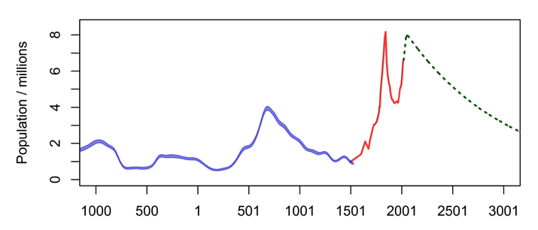
III. Late Iron Age: Homogenisation of Irish?
A model for the homogenisation of Irish
Great Upheaval of the Phonological System (GUPS) in 5th-6th c. a.d. caused by rapid language shift?
pre-Celtic surviving in Ireland in 5th c. a.d. (Schrijver 2000, 2005)
external factors:
mid-6th century famine
and epidemics
internal unrest & mobility
linguistic leveling
early medieval spike
death of pre-Celtic language?
‘Late Iron Age lull’
mid-6th cent. plateau climate disaster, epidemic
early modern spike
death of the Irish language
Graph: R. McLaughlin, Emania 2020: 24

Slide 20
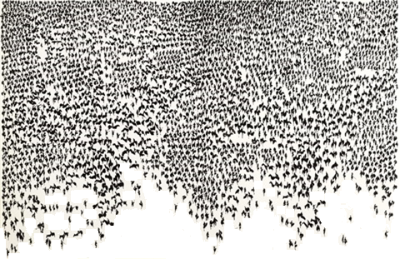
Ad·tlochur indithim dúib!
Thank you very much for your attention
Prof. David Stifter MRIA
Dept. of Old and Middle Irish
School of Celtic
Maynooth University
david.stifter@mu.ie
@chronhib
Population growth
The Táin. Army massing, Louis le Brocquy (1969)

